Slide 1
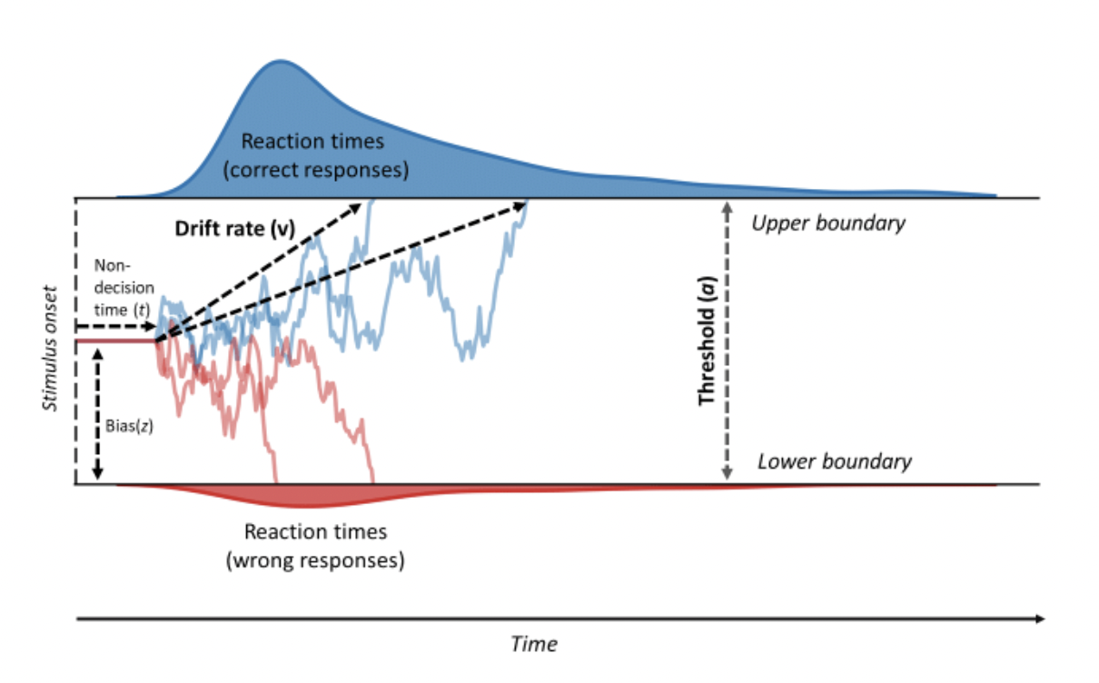
Drift Diffusion Modeling
Luc Vermeylen
Department of Experimental Psychology,
Ghent University
Granada, 2nd June 2022

Slide 2
Who are you?
Students? Doctoral students? Post-docs?
RT experience?
Computational modeling experience?
DDM experience?

Slide 3
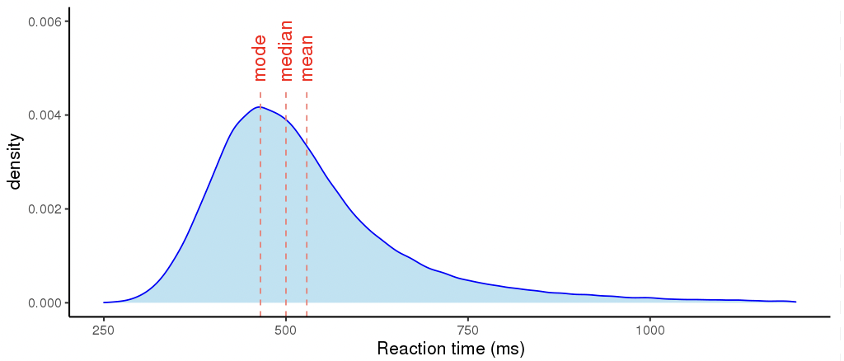
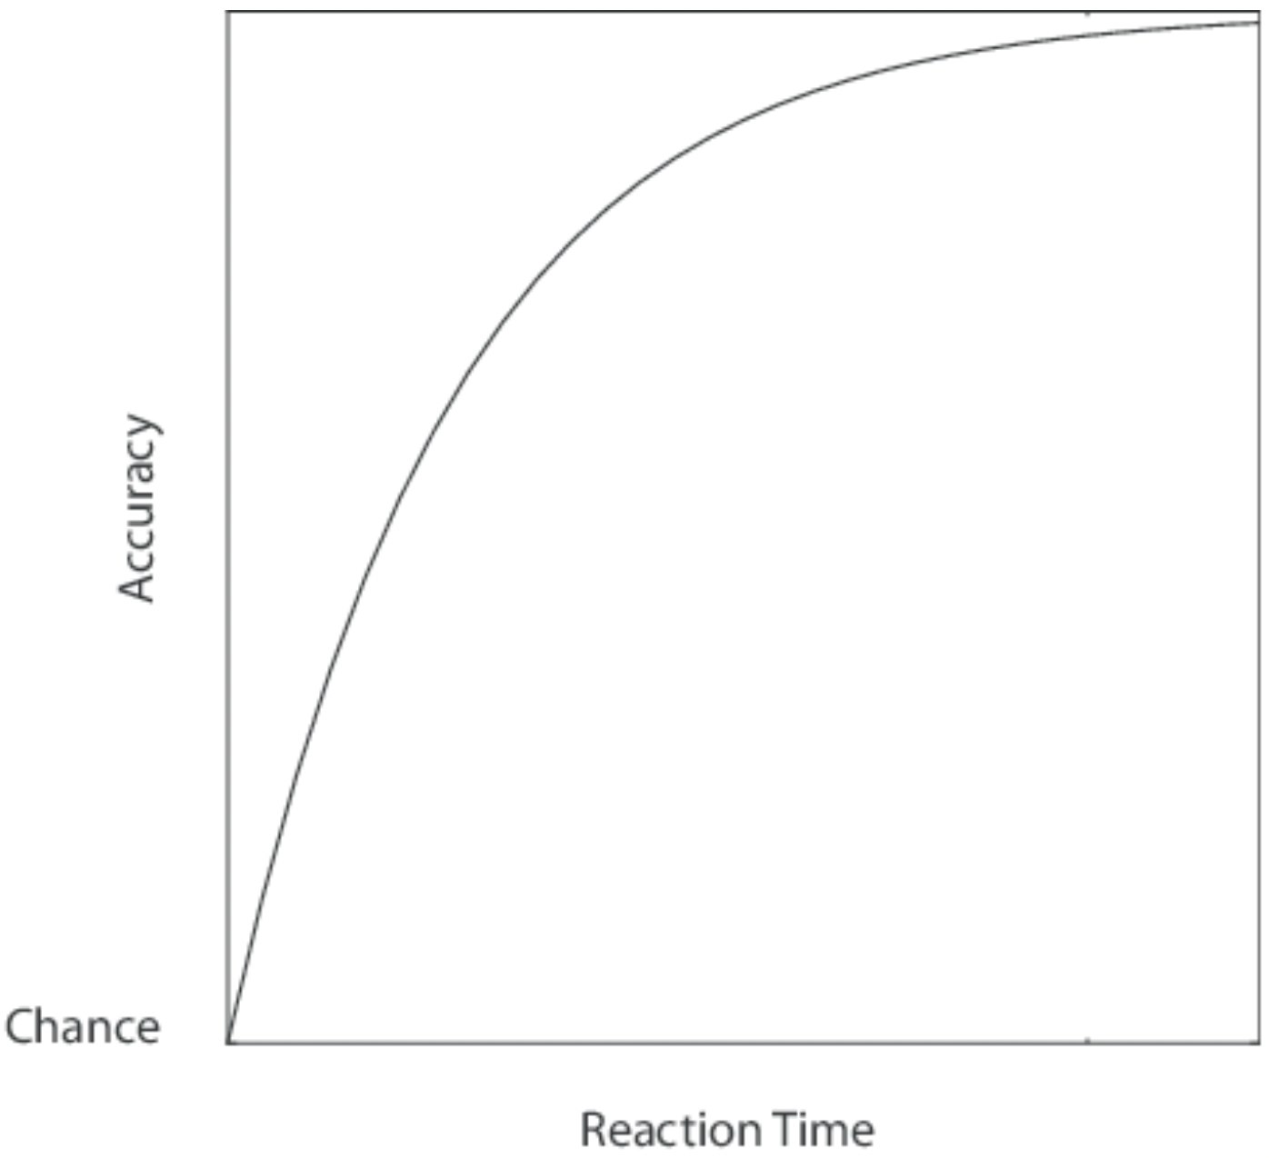
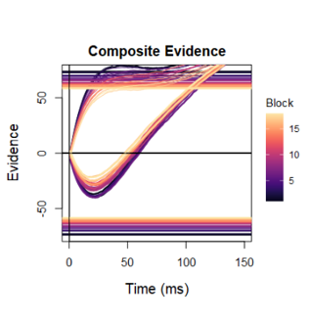
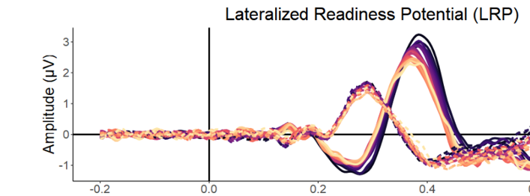
Why DDM for behavior?
RT distributions are skewed
Choices included in the model
Psychologically meaningful processes
Neural plausability
Speed-accuracy tradeoff
Latent Decision Variable

Slide 4
Goal of today: DDM as a window into computational modeling
Going from a theoretical description to programming code
Understanding the model through Monte Carlo simulations
Learning how to fit models (objective functions & optimization)
Model assessment (fit assessment & parameter recovery)
These are the basic abilities of any computational approach!
Anyone can learn to use a package (e.g., HDDM) through its documentation, but these skills are invaluable to understand what is happening inside the black box.
Sets you en route for more complicated DDM’s, but also other models (RL)
Part 1
Part 2

Slide 5
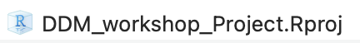
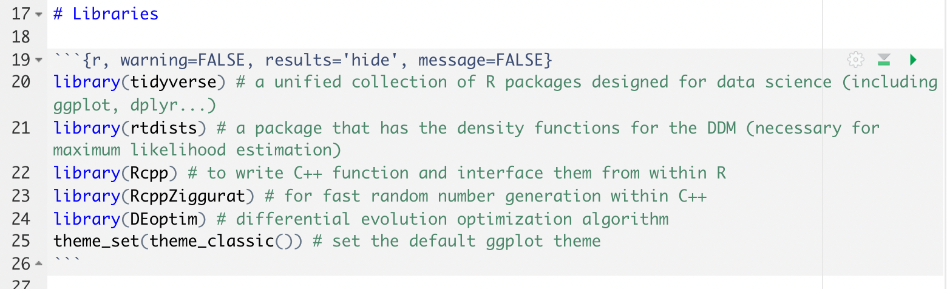
Let’s group up and start (the troubleshooting?)!
Open Rstudio by clicking the project file
Next, within Rstudio open the file “DDM_Workshop_Exercise.Rmd”
This is a R markdown / notebook file
Code is organized in “chuncks”
Run the first chunck, which loads the libraries

Slide 6
Part 1: Simulating the DDM
Noisy Evidence Accumulation
Parameters
Constants
Accumulating Evidence
Absorbing Boundaries
Non-Decision Time
Standard DDM
Full DDM
Visualization

Slide 7
Part 2: Fitting the DDM
Increase speed of computation
Objective Functions
Kolmogorov-Smirnov
Multinomial Likelihood
Maximum Likelihood
Mixture Model
Optimization
Parameter Recovery
Fit Assessment

Slide 8
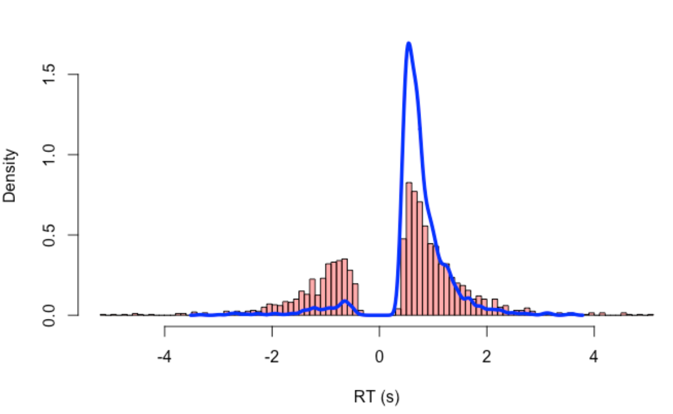
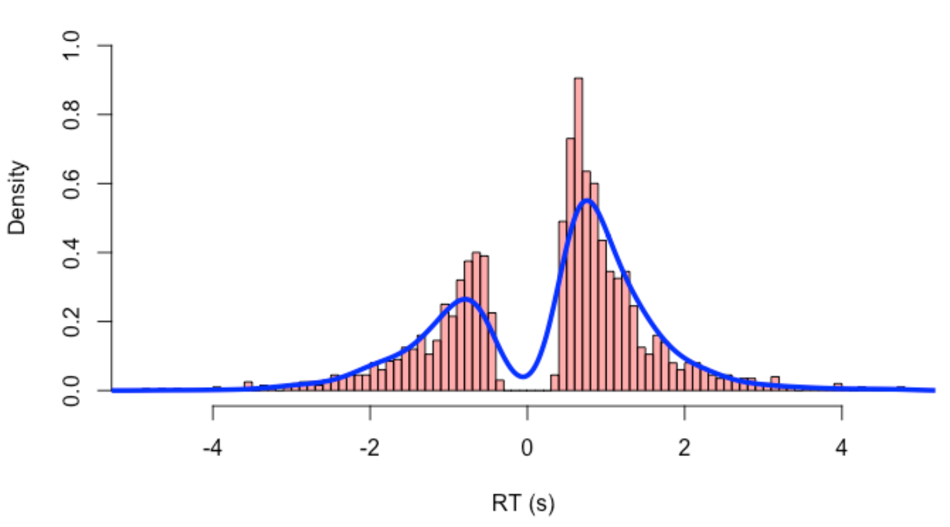
Objective Functions
We need to find the parameters that best explain our data
An objective function quantifies the difference between our observed data and the data generated by some given candidate parameters
Next, an optimization algorithm can adjust the candidate parameters so that the misfit between observed and predicted data is minimized

Slide 9
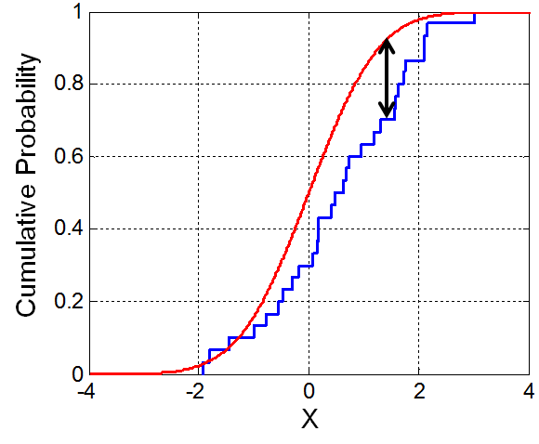
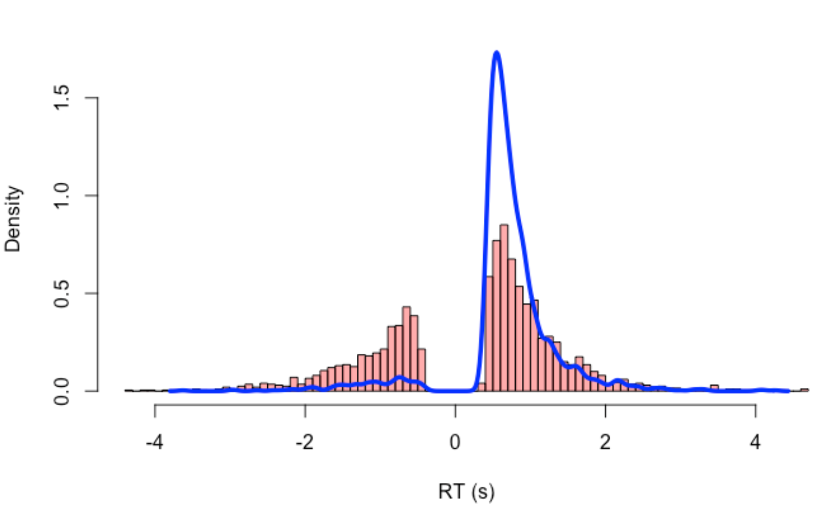
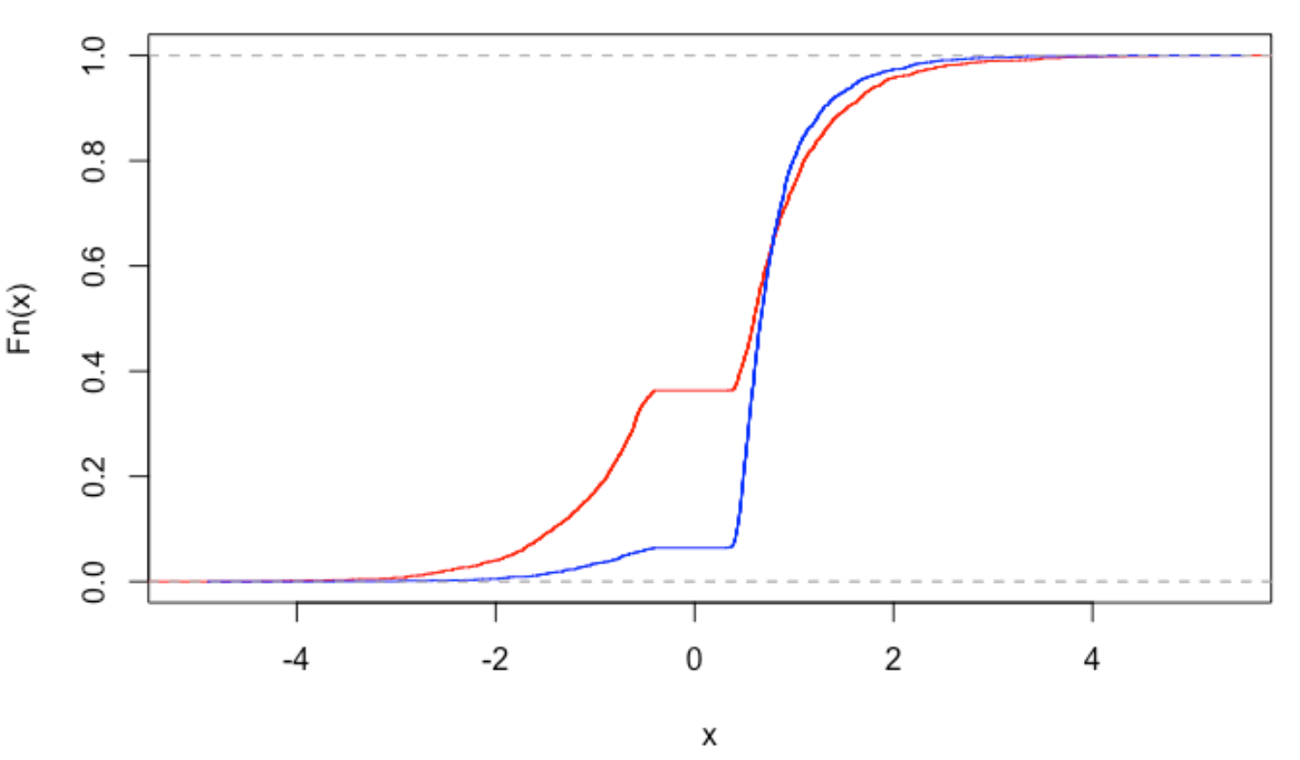
Kolmogorov-Smirnov (KS)
The test statistic (“D”) of the KS test is the maximum absolute difference between two cumulative distribution functions
Problem: we have two distributions… so we combine them!
CDF
PDF
CDF

Slide 10
Kolmogorov-Smirnov (KS)
Advantage:
No need for analytic likelihood (any model you can simulate for, you can fit)
Very simple to calculate
Not sensitive to outliers
Disadvantage
No metric for model comparison

Slide 11
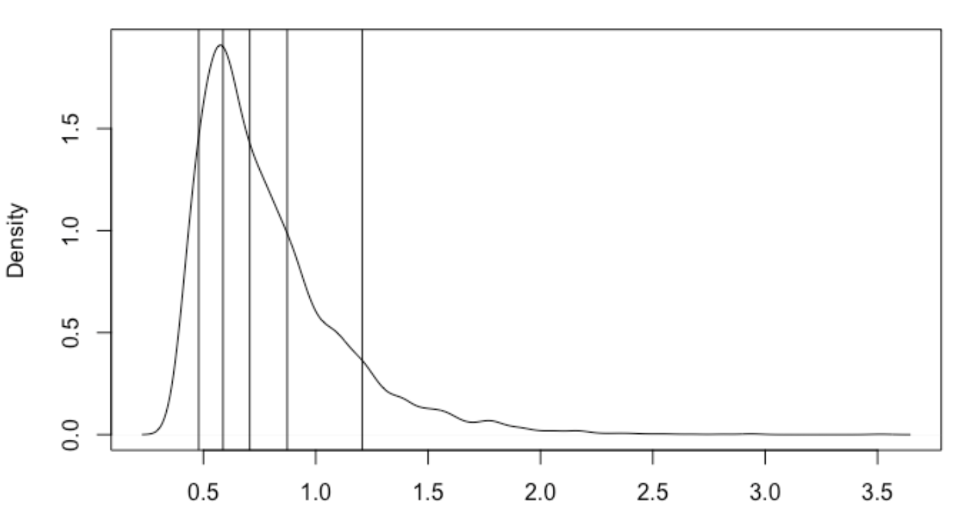
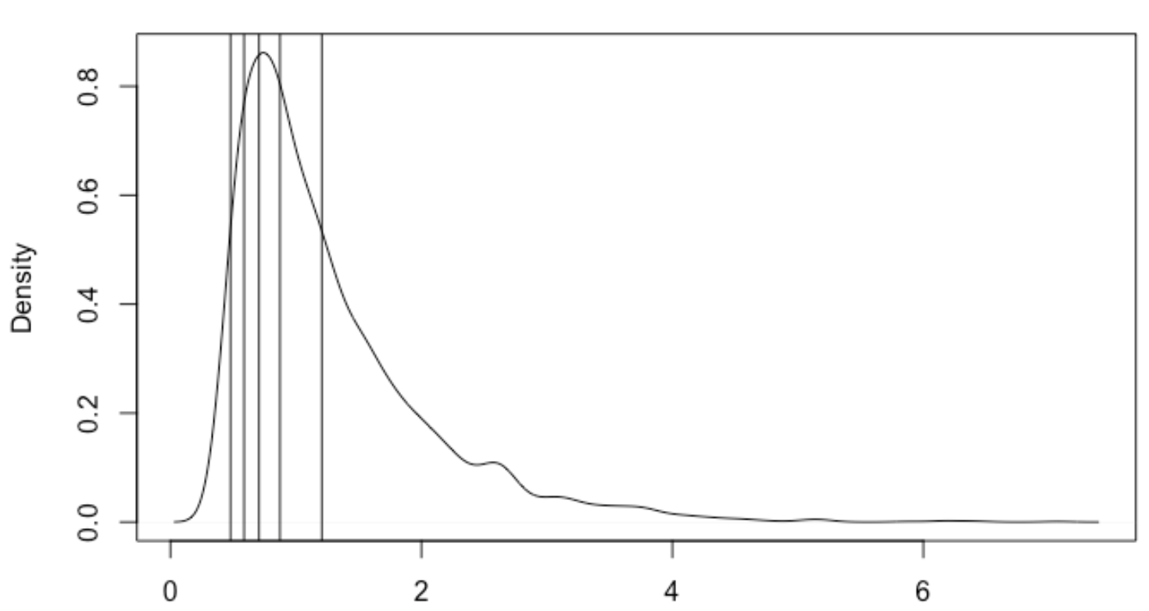
Multinomial Likelihood (G²)
Compute proportion between quantiles (e.g., .1, .3, .5, .7, .9) on observed data
=> is by definition 10% 20% 20% 20% 20% 10%
What is the proportion between the quantiles (from the observed data) applied on the predicted data?
Next, quantify the mismatch:
G² = 2 * N * sum(observed_proportion * log(observed_proportion/predicted_proportion))
AIC = −G² + 2*k, where k, where k is the number of parameters
BIC = −G² + k*log(N), where N is the number of observations.
These are calles approximate AIC/BIC, because not based on the true likelihood.

Slide 12
Multinomial Likelihood (G²)
Advantage:
No need for analytic likelihood (any model you can simulate for, you can fit)
Not sensitive to outliers
Disadvantage
More tricky to code, but overall the preferred choice for simulation-based fitting (i.e., when you don’t have the analytic likelihood available)

Slide 13
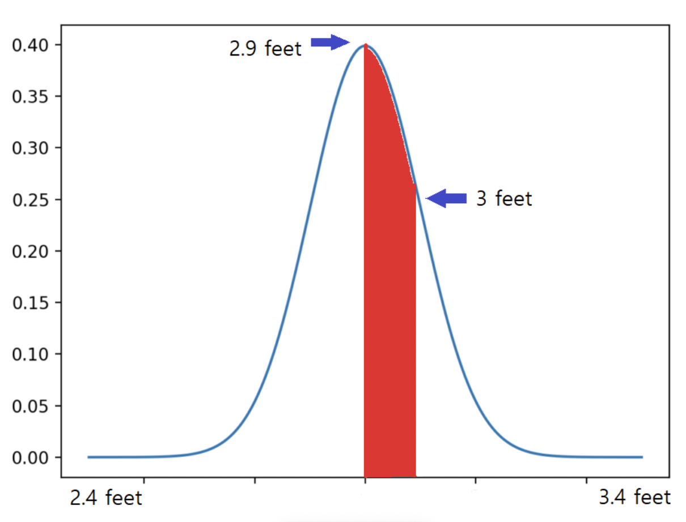
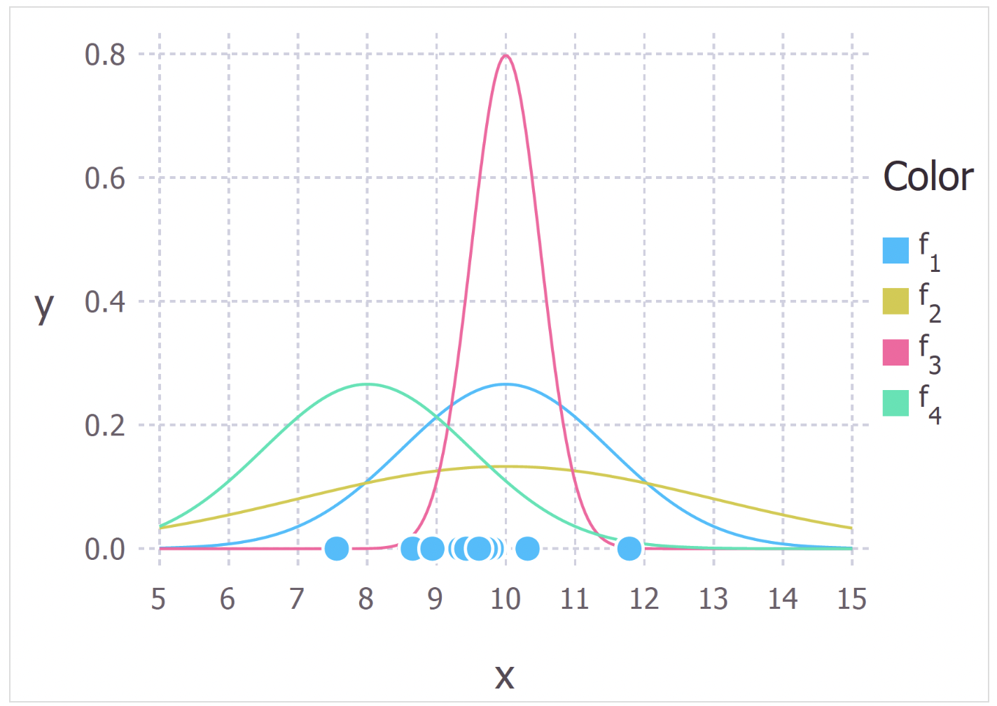
Maximum Likelihood (ML)
Probability: P(data|distribution)
You ask a question about your data
GIVEN a distribution (e.g., N(0,1))
=> the distribution is fixed, and ask questions about different sets of data
= Area Under the Curve (AUC) and sums to 1
Likelihood: L(distribution|data)
You ask a question about your distribution
GIVEN a set of data
=> the data is fixed, and you ask questions about different sets of distributions
Does not sum to 1 (higher is simply better fit)
Maximum Likelihood:
You shift the parameters of the distribution
So that you maximize the likelihood of the data
“find the distribution that best explains the data”

Slide 14
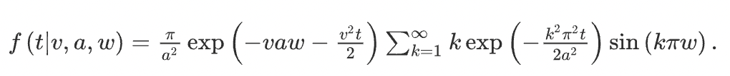
Maximum Likelihood (ML)
For ML, we have to calculate the density of our datapoints given a model
This is basically a mapping from parameters to density points
This is available for many theoretical distributions such as the normal distribution, but is not straightforward for DDM because of its stochastic nature.
Luckily, we do have the density function available.
Disadvantage: this is only true for the standard DDM. For more complicated models we do not have density functions available and have to rely on model simulations to quantify how well a given model approximates the data.

Slide 15
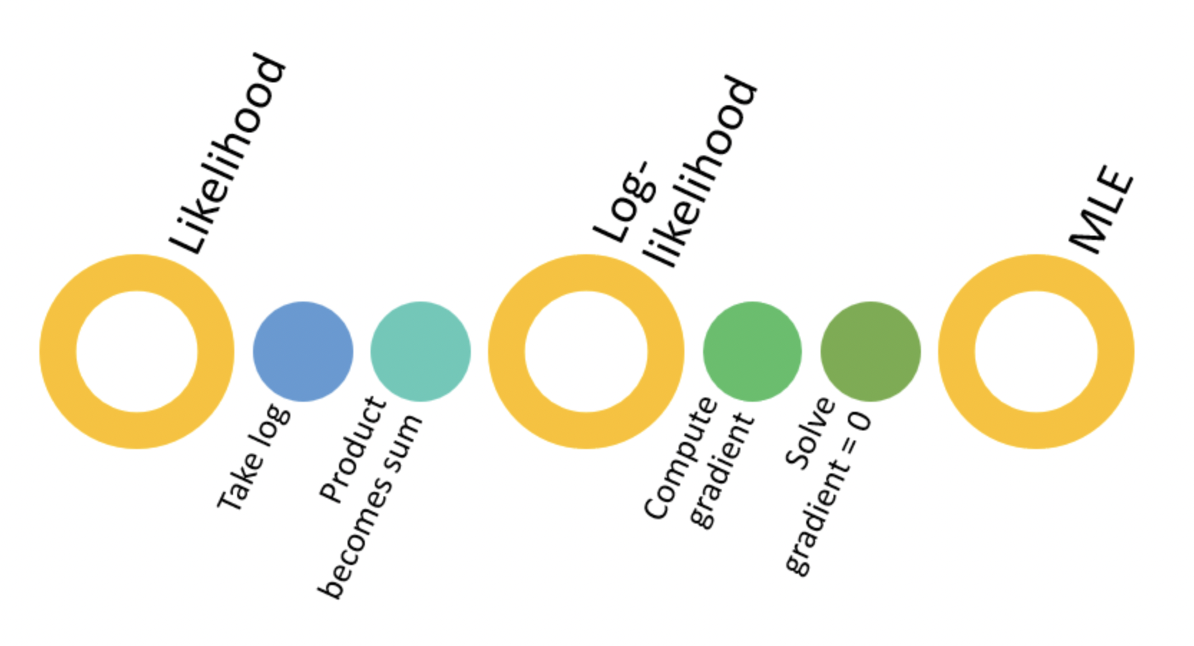
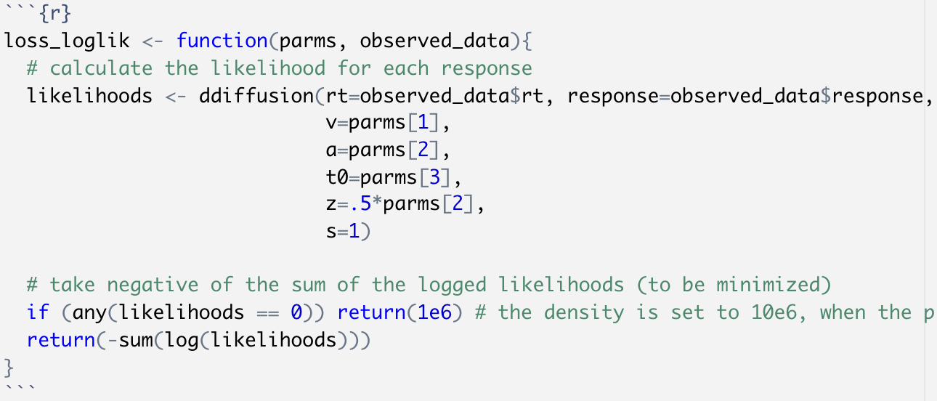
Maximum Likelihood (ML)

Slide 16
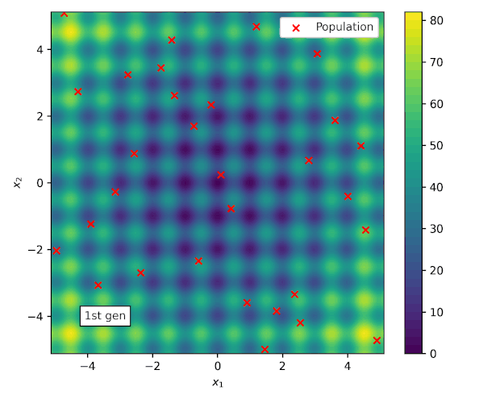
Differential Evolution (DE) Optimization
A very powerful optimization method that can solve high-dimensional problems
the DE algorithm works by having a population of candidate solutions (called agents)
moved around in the search-space by using simple mathematical formulae to combine the positions of existing agents from the population
If the new position of an agent is an improvement then it is accepted and forms part of the population, otherwise the new position is simply discarded
The process is repeated and by doing so it is hoped, but not guaranteed, that a satisfactory solution will eventually be discovered.

Slide 17
DDM in the wild
If you have enough trials (which you can assess yourself using parameter recovery), you can now fit DDM’s yourself from scratch! No need for a package.
If you don’t have enough trials, you might want to consider hierarchical Bayesian estimation procedures:
HDDM package in Python (Wiecki et al., 2013)
DMC in R (Heathcote et al., 2019)
If you are interested in more complex models, you can:
Simulate them yourself and fit using multinomial likelihood or KS
pyDDM package in Python (Shinn et al., 2020)
ChartR in R (Chandrasekaran et al., 2019)
Neural-network extension of the HDDM package

Slide 18
Recommended Reading
Forstmann, B. U., Ratcliff, R., & Wagenmakers, E. J. (2016). Sequential sampling models in cognitive neuroscience: Advantages, applications, and extensions. Annual review of psychology, 67, 641-666.
Wiecki, T. V., Sofer, I., & Frank, M. J. (2013). HDDM: Hierarchical Bayesian estimation of the drift-diffusion model in Python. Frontiers in neuroinformatics, 14.
Vandekerckhove, J., & Tuerlinckx, F. (2007). Fitting the Ratcliff diffusion model to experimental data. Psychonomic bulletin & review, 14(6), 1011-1026.
Ratcliff, R., & Tuerlinckx, F. (2002). Estimating parameters of the diffusion model: Approaches to dealing with contaminant reaction times and parameter variability. Psychonomic bulletin & review, 9(3), 438-481.
Voss, A., Rothermund, K., & Voss, J. (2004). Interpreting the parameters of the diffusion model: An empirical validation. Memory & cognition, 32(7), 1206-1220.
Lerche, V., & Voss, A. (2016). Model complexity in diffusion modeling: Benefits of making the model more parsimonious. Frontiers in psychology, 7, 1324.
Boehm, U., Annis, J., Frank, M. J., Hawkins, G. E., Heathcote, A., Kellen, D., ... & Wagenmakers, E. J. (2018). Estimating across-trial variability parameters of the Diffusion Decision Model: Expert advice and recommendations. Journal of Mathematical Psychology, 87, 46-75.
Matzke, D., & Wagenmakers, E. J. (2009). Psychological interpretation of the ex-Gaussian and shifted Wald parameters: A diffusion model analysis. Psychonomic bulletin & review, 16(5), 798-817.

